Slide 1
Application Fraud Model Workshop CCRC
Derek Dempsey,
Director, Data Science
Advisors, FICO
August, 2016

Slide 2
Agenda
Introduction to Application Fraud Models
Developing the Model Dataset
Data Requirements
Sampling, Target Definition, Volumes
Model Design
Model Types
Scorecards, Neural Networks
Exclusions, Regulatory constraints
Model Development
Variable development, iterative cycles

Slide 3
Agenda (cont)
Performance Review (Development)
Metrics
Iterative cycles
Validation
Performance Review (Operational)
Threshold setting
Performance Measurement
Model Development Plan and Schedule
Model Validation (Client)
Risk and Fraud models compared

Slide 4
Application Fraud Models
Introduction

Slide 5
Application Fraud Models
The main goal of application fraud analytics is to provide a complete detection solution for application fraud: The two main fraud types are:
Identity Theft / Impersonation (3rd party)
1st party (No intention to pay)
The concept of analytical ‘model’ should include the development of a range of analytical techniques rather than dependence on specific methodology (i.e. scorecards).
3rd Party
Credit Card / Revolving Credit
Consumer Loans
Insurance Policy
Application Segments by product and line of business
Mortgage
Personal loans
Credit line
Auto Loans
Mobile Phone
Insurance Policy
Mobile Phone
1st and 3rd Party
Credit Card / Revolving Credit
Consumer Loans
Insurance Policy
Mobile Phone
Tagged Fraud Data with Type Distinctions
OR
Agreed Fraud Definition
Fraud Tags no Type Definition
OR
Insufficient data

Slide 6



Model Development
1
Review existing practices with client investigators/ fraud analysts to understand the data on which their decisions are typically based, patterns of fraud currently spotted, and the available data used to make the assessment
5
Deliver Fraud model(s) Test and validate
Model Development
2
Create an extract of historical data
= Σ{
Extract
Age
Occupation
Address
Credit history
ID
Phone Number
Employer Name
Employer Address
Channel
Pg fg (s)
Score
f (s)
s>s*
12 to 15 months data (e.g.: Claims, Applications)
Results
Collect
Historical Data
4
Model Training Process Generate behavioural variables, train/compare against normal patterns to identify outliers and train final fraud model
3
Create a dataset of identified fraud patterns and activities
Identity Date reported; how verified; name; DOB; address; phone
Transactions Claim type, date detected; associated parties; damage/injury details; …
Historical Fraud Status Data

Slide 7
What are the key elements to building a Fraud Model?
Application
Age, Gender, Address, Contact Info
Occupation
Applicant
Business, Consumer, Self Employed
Industry Files
Bureau
Product
Authentication
Customer
3rd Party Data
Time at Address, Time at Employer
Payments, Delinquency
Cards, Loans, Mortgages, Vehicle Financing
Retail/Checking/Current Accounts
ID Type & Number
Documentation
Time with bank
Other Accounts & Payment history
Industry Negative Files eg CIFAS
Deceased Register, Sanction List, Phone Number Lookups, Address Changes
Performance
Frauds,
Suspects
Models
Minimum 12 months of historic data for observation data.
Model data specification should conform to AFM Data Specification.

Slide 8
How do Models Work?
Each variable provides a risk element
Higher probability or likelihood of fraud
The combination of many small fraud risk elements makes a robust model.
Model elements, such as age or gender, can influence a decision without determining a decision. For example:
Age = 19 – 24 (higher risk band)
Gender = Male (higher risk category)
Rules essentially require ‘determining’ elements.
Risk Score
Age
Marital Status
Time at Bank
Occupation
Previous Applications
General Additive Model (GAM)

Slide 9
Application Fraud – Definition Summary (Qualitative)
Includes both 1st and 3rd party at application
Includes ‘sleeper’ accounts as well as early payment defaulters
Most 1st party ends up in bad debt.
3rd party fraud is more clear cut. There is a victim who has been impersonated.
Some 1st party is passed off as 3rd party. “It wasn’t me. Someone must have stolen my ID”
Organised fraud rings employ ‘mules’ to open accounts for money laundering or large-scale ‘bust-outs’. They provide employment bona fides and pay small commissions.

Slide 10
Fraud Case Data – (Performance Data)
To build an empirical model target data is required:
For Application Fraud these should be confirmed application fraud cases.
Pre-book – stopped at application
Post-book – identified in collections OR by definition from default data
A robust model requires 1000+ fraud cases (ideally 1500+)
Either large portfolio
Long history
Often a challenge for empirical fraud model development
Some portfolios, (home loans, SME) typically have few confirmed cases but high value.
Option to expand definition to include ‘suspect’ or ‘high risk’ cases
Typically application fraud models are NOT used to auto-decline but to require additional scrutiny / challenge / checks through review process.

Slide 11
Product Segments – Models
Typical Structure
Credit Card / Credit Line models
Credit models can be built using standard data and fraud definition based on default analysis
Credit Card
Current Account
Personal Loan
Loans Model(s)
Loans Model(s) may combine or segment portfolios
Auto Loan
Home Loan
Home Loan
Typically have low case volumes and require special treatment.
SME
SME
SME models require very specific data.
Negotiation between fraud type, data specialisation and data availability

Slide 12
Applicant or Customer Level Analytics?
Typically systems operate at Application Level
They may include Customer Level details
Customer-level variables can be good indicators
Highest fraud risk associated with new applicants however
How is this addressed at customer level?
Application Level
Application Data
Application Data
Customer Level
Application Data
Enriched Application
Limited Customer Data
Limited external data
Bureau Data
Bureau Data
Bureau Data
Detailed Customer Data
External data
What if this is identity theft of existing customer details?
How much customer data is accessible in originations process?

Slide 13
Rules-based vs Predictive Analytics Approach
A detection approach for application fraud based solely on rules has advantages and drawbacks. These include:
Advantages:
Easily understood
Adjustable by the business user
Disadvantages:
Low detection rates
Easily avoided by fraudsters
Detect only what is already known
Predictive analytics are objective rather than judgemental.
Assume that the past is our best guide to the future.
The main features of analytic methods are:
Combine multiple data elements.
Data-driven.
Use derived variables to make data more effective.
Produce a single fraud risk score or rank ordering.
Can be combined with strategy rules for optimum effectiveness
If score > 700 and location = ‘Shanghai’ then refer to Fraud Queue X.
Optimum Fraud Detection includes both analytics & rules

Slide 14
Data Requirements for Application Fraud Models

Slide 15
Data Requirements for Application Fraud Analytics
Application Data
Bureau Data
Customer Data
Other Data (e.g. external enrichment)
Performance (Outcome) Data
Centralize fraud intelligence and reporting

Slide 16
Application Data Processing
What information is in the Application Data record?
Product, Channel, Process considerations:
Branch
Credit Card
Credit Checks
Fraud Checks
Decisioning
Mobile
Current Account
Application Processing
Personal Loan
Internet
Auto Loan
Dealer
Home Loan
Broker
SME

Slide 17
Application Data Record
Application Fields
Accepted Application Details
Applicant Details, Address & Demographics
Employer Details
Employer Name & Address
Applicant
Customer
Product Details
Customer Details (existing customer)
Card Type, Cr. Limit, Loan Type, Term, Secured/Unsecured
Guarantor Name, Address & Occupation
Guarantor Details
Application Type
Single or Joint

Slide 18
Application Data Specification
Review Spec
Data Mapping exercise with each client supplying data
Confirm formats
Date
Number
Category Mapping

Slide 19
Bureau Data
Model Data Specification:
Bureau Data (Credit History) varies:
Different Countries
Different CRAs
Coding required to generate Bureau file variables
Fraud model variable selection may be pragmatic:
Can use same variables available for credit score for Fraud Model
Which Bureau Variables add value?
Recent self-searches can be indicative of Identity Theft
Poor credit history can be indicative of First Party fraud

Slide 20
Sample Bureau Variables in Application Fraud models
Name | Description | Type of Characteristic
MaxDelqEver | Maximum Delinquency Ever | Generated Bureau – higher delinquency equates to higher probability of fraud
NetFractRevBurden | Net Fraction Revolving Burden | Generated Bureau – Gaussian distribution; 5-10% have lower probability of fraud
MthsMostRecentDtOpen | Months since most recent date opened | Generated Bureau – Gaussian distribution; 6 – 60 months since most recent date opened have lower probability of fraud
MthsMostRecentDtLastActivityRev | Months since most recent date last activity revolving | Generated Bureau – longer time since most recent date of last activity equates to higher probability of fraud

Slide 21
Performance Data
To develop effective data-driven fraud analytics we need useful fraud outcomes data or fraud tagging
Requires agreed fraud definition
Requires operational process to allow correct fraud assignation to be made.
Agreed fraud classification
Fraud type description
Retrospective data review to identify fraud not captured at application OR defined as first party.

Slide 22
Other Data Sources
External (non-bureau) data:
Industry Negative Lists (data sharing)
E.g. UK – CIFAS, IFB
Industry Alerts
Formal or informal information exchange about fraudulent activity
Alerts to specific regions, towns, people, operations (organized activity)
Government Sources
Court Cases, criminal record (may be provided to Bureau).
Bankcrupcy, civil cases (may be provided to Bureau)
Third party data providers
‘Hot’ IP lists
Device profiing (Iovation, 41st Parameter)
Negative Data (3G, etc.)

Slide 23
Industry and Product Considerations
In addition to 3rd party / 1st party fraud considerations there are industry and product factors to take into account.
Industry specific models are default cases:
Financial Services / Banking
Insurance Policy Application
Telecommunications (Subscriptions)
Retail (On-line)
Within Financial Services further segmentation can apply:
Revolving Credit (Credit Card)
Consumer Loans
Secured (Auto Loans)
Unsecured (Consumer Loans)

Slide 24
Developing the Modeling Dataset

Slide 25
CCRC Data
Total Observation Data: Accounts Opened - Jan 2012 – Dec 2014
Data from 4 banks & 28 Provinces
Sample for Rules / SNA development
2 cities (Chongqing (~3m records) and Shanghai (~12m records)).
10% sample: All fraud + down-sampled randomly (~10%) goods)
~300,000 + ~1,200,000 = ~1,500,000 records (applications)
1.5m records @ 0.0061 (0.6%) sample fraud rate = ~9150 fraud records
Total Cust | Total Acct | Total Fraud | AFR | CFR
117,000,000 | 210,000,000 | 128,000 | 0.00061 | 0.001094017

Slide 26
Modeling Data (Sampling)
Use the same sample as SNA / rules development for model or different sample?
Same:
We want to see how the model will work with the rules and IRE.
We want to identify the overlap
Do we want to use SNA variables within the model? If so should use same sample.
Measure combined performance
Identify and test output record
Different:
Include different geography
Validate over different sample
Reduce dependence on contingent effects. Need to be careful NOT to use one sample for all development.

Slide 27
Modeling Data (Sampling)
Assume same sample ~1.5m records, ~9k frauds
Model build tools (SAS, MB7)
Options:
For model build can down-sample to 1:1 (goods:bads)
Recommendation is 10:1 (goods:bads)
Validate by scoring full dataset
For risk tables should use full sample dataset
Geographic risk, time of day risk, product type risk, channel risk, etc.

Slide 28
Segmentation
Model Build:
Large data sample so segmentation options are viable:
Information-based:
Bureau data or no bureau available
Validation:
Banks may request validation file on own data
Different banks may have different fraud rates.
Could influence sampling policy
Performance tracking – individual client validations

Slide 29
Data Consistency
For the Bureau solution one of the key difficulties is consistency of application data.
Different categories / classifications / etc.
May need to normalise across 4 banks providing data.
Will need to monitor all other banks when operational for data variation.

Slide 30
Model Design

Slide 31
Model Design considerations
Define Dataset
Fraud Definitions
Observation Data (activity or behavioural data)
Performance Data (what was the result?)
Application fraud
Observation data = applicant details over period of time (e.g. 12 months)
Performance data = applicants from observation period classified as fraud
Based on definition
Exclusions
Model Type

Slide 32
Fraud Definition
Utilization > 50% & TPD and < 6 months on book
Utilization > 100% and FPD
FPD & balance > 500 & utilization > 70% & (current status is charge off or M7+)
SPD & balance > 500 & utilization > 70% & (current status is charge off or M7+)
Balance > 500 & utilization > 87% & (current status = charge off or M7+) & no payment after limit increase
Account Level definition
Rules are applied at Account Level
Need to consider 3rd Party account compromise
Responses are requested at Account Level

Slide 33
Exclusions
Other fraud types not covered by definition (e.g. 3rd party fraud)
Other default conditions
Suspected fraud?
Specific applicants / products / special cases?
Regulatory Constraints
Variables cannot be used? (In US, gender, ethnicity …)
Variables which client doesn’t want to use.

Slide 34
Model Types
Scorecard:
Typically the standard approach for application fraud models. Provides transparency, ease of deployment and weights adjustment options.
Tree Ensemble Models (Random Forest)
This approach has shown good and improved results but requires an implementation mechanism.
Neural Networks
Used (by FICO) for transactional fraud detection. Includes variable interdependence.
Bayesian Networks, Support Vector Machines.
Outlier Analytics
Can be used if limited or no fraud case data

Slide 35

Performance Data (known vs unknown)
Supervised vs. unsupervised requirement
Supervised
Unsupervised
Bad
Learn patterns to identify groupings
Can identify and ‘tag’ bads to differentiate

Slide 36
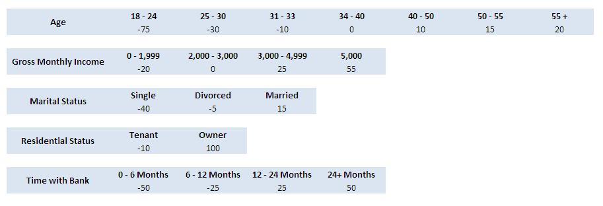
Modeling Methods - Scorecards
General Additive Models
These are models where each variable (or characteristic) is assigned a score which is added to make the overall score:
Score = A(x_{A}) + B(x_{B}) + C(x_{C}) + D(x_{D})
Commonly use logistic regression to fit to objective function (target)
Important Factors are:
Independence of inputs
Acceptability of inputs
Salience
Inputs make sense
Weights Structure
Weights make sense
Monotonic (?)

Slide 37
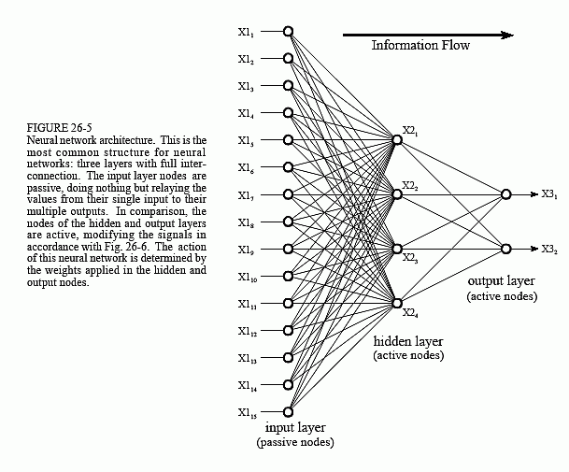
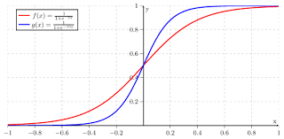
Modeling Methods – (Artificial) Neural Networks
Based on the way the brain works
Network Architecture
Each input affects all middle (decision) nodes
Robust to information loss (data not available)
Better generalisation capacity
LIMITED transparency about decision.
But may make ‘better’ decisions
Outcome difficult to predict
Fraudsters not able to manipulate data …
Many input elements
Can incorporate high number of inputs
Re-trainable (to a degree)
More complex implementation
Activation function (e.g. sigmoid)defines behaviour of hidden nodes
Notes:
p

Slide 38
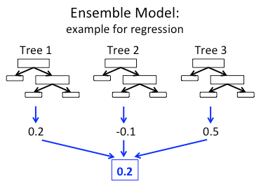
Tree-Ensemble Models (TEMs)
Tree-Ensemble Models are multiple models built from different data selections that then provide a committee of experts to determine an output.
In the example, three decision trees each produce a different result.
The overall result is delivered as the output.
( 0.2 + (-0.1) + 0.5 ) / 3 = 0.2
Other options exist
Provided the sub-models are diverse the collaborative output is often better that any single model.

Slide 39
Considerations on Performance Inference
Do not have the declined frauds …..
In credit models performance inferencing can be used to model the declined application performance and thus provide a complete population for modeling.
Have not used in Application Fraud models due to difficulty in modeling declined application performance.
Typically, observation set is approved applications only.
May use fraud declines within fraud cases to expand fraud data.
Not required if large fraud case set based on definition.

Slide 40
Model Build

Slide 41
Objective of Analytics for Application Fraud
FRAUD and NON-FRAUD SCORE SEPARATION
Percent
% Non-Frauds
% Frauds
Advanced Analytics increases the concentration of fraud relative to good transactions at high score thresholds
Advanced Analytics decreases the concentration of fraud relative to good transactions at lower score thresholds
While minimising the false-positives
While minimising the false-negatives

Slide 42
Model Performance Review - Development
Dependent on model type:
Test – Train methodology
Split into Train / Test sets (Range from 70:30 to 50:50)
Standard Metrics
GINI, ROC, K_S, Information Gain
RMS error (e.g. Neural Network)
Fraud Metrics (operational metrics)
Review Rate
Fraud Detection Rate
False Positive Rate

Slide 43
Fraud Model Thresholds
The fraud model thresholds are typically based on the model report which details for each score point T:
Review Rate – % of applications referred at T
This is used to calculate the number of applications that will be referred to fraud team
False Positive Rate – ( # non-frauds / # frauds ) at T
This is a measure of accuracy at a given threshold
Fraud Detection Rate - # frauds detected at T / total frauds
This measures completeness or coverage at a given threshold
Value Detection Rate - # value of frauds at T / total value of frauds
This measures the value detected at given threshold so provides a basis for ROI calculation.
Thresholds can be low (fast-track) or high (referred)
FICO Advisors team can work with clients to optimise model threshold settings.

Slide 44
Model results and implementation
Improved fraud models yield greater detection, fewer reviews, or both
100%
Model A
Model B
2
% Fraud Detected
3
1
Random
1
Current detection rate and review rate
Reduce fraud losses at same review rate
Increase approvals at same detection rate
2
3
% Cases Reviewed
100%

Slide 45
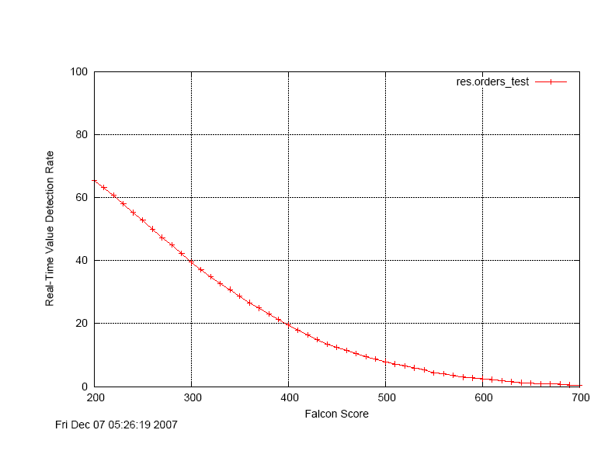
Value Detection
The value of the fraud detected can be calculated as a function of the score.
This can be used with a cost estimate to generate an ROI curve.
The value detected by the model is the order amount saved at the point of referral.
This depends on HOW QUICKLY a fraud is detected as well as value of orders.
The value rate curve shows the amount saved as a proportion of total Fraud losses.
35% of Fraud losses = $3.8m AND 58% of Fraud losses = $6.1m
35
320
Real Time Value Detection vs Score Threshold

Slide 46
Fraud Losses and model Cost-Benefit (ROI)
Status | Transactions Referred | Declined for Fraud | Loss $m
Fraud | 120000 | 40000 | 6.00
Year 1 Fraud Losses
Assume 12 fraud analysts
Cost of a referral based on figures provided:
Referrals per FTE = 120,000 / 12 = 10000 per year per FTE
Avg ‘cost’ can be calculated based on a cost per FTE.
For example = (20000*1.5) / 10000 = $3.5 per referral
At 4% referral rate for applications:
120,000 referrals per year
Cost = 120,000 * 3.5
= $420,000 (£0.42m)
Savings at 4% review rate = $3.8m
Model Benefit = $3.4m – Solution Cost

Slide 47
Model Report
Fraud model provides a score for each application.
Threshold Score | AFPR | ADR | VDR | Review Rate
200 | 2.76 | 69.25 | 65.45 | 12.73
220 | 2.53 | 63.71 | 60.66 | 10.84
230 | 2.43 | 61.05 | 58.02 | 9.98
240 | 2.33 | 58.12 | 55.20 | 9.15
250 | 2.23 | 54.87 | 52.82 | 8.33
260 | 2.15 | 51.53 | 49.97 | 7.59
270 | 2.07 | 48.44 | 47.29 | 6.89
280 | 1.97 | 45.69 | 44.93 | 6.26
290 | 1.90 | 42.56 | 42.32 | 5.67
300 | 1.84 | 39.56 | 39.43 | 5.11
310 | 1.75 | 36.87 | 37.09 | 4.62
320 | 1.70 | 34.01 | 34.81 | 4.15
330 | 1.62 | 31.39 | 32.71 | 3.71
340 | 1.55 | 29.01 | 30.76 | 3.34
350 | 1.50 | 26.61 | 28.68 | 2.99
360 | 1.44 | 24.38 | 26.59 | 2.67
380 | 1.33 | 20.52 | 23.09 | 2.12
390 | 1.29 | 18.56 | 21.28 | 1.88
400 | 1.25 | 16.63 | 19.56 | 1.66
410 | 1.20 | 15.13 | 17.88 | 1.48
450 | 1.01 | 9.75 | 12.50 | 0.88
460 | 0.98 | 8.73 | 11.47 | 0.77
500 | 0.83 | 5.19 | 7.86 | 0.44
550 | 0.70 | 2.42 | 4.39 | 0.20
560 | 0.67 | 2.12 | 4.03 | 0.18
600 | 0.46 | 1.11 | 2.47 | 0.09
650 | 0.33 | 0.34 | 1.04 | 0.03
700 | 0.20 | 0.03 | 0.37 | 0.01
1000 | 0.00 | 0.00 | 0.00 | 0.00
The model report details the performance of the model. It is used to determine the optimal threshold to use with respect to:
review rate,
accuracy (ADR)
false positive rate (AFPR).

Slide 48
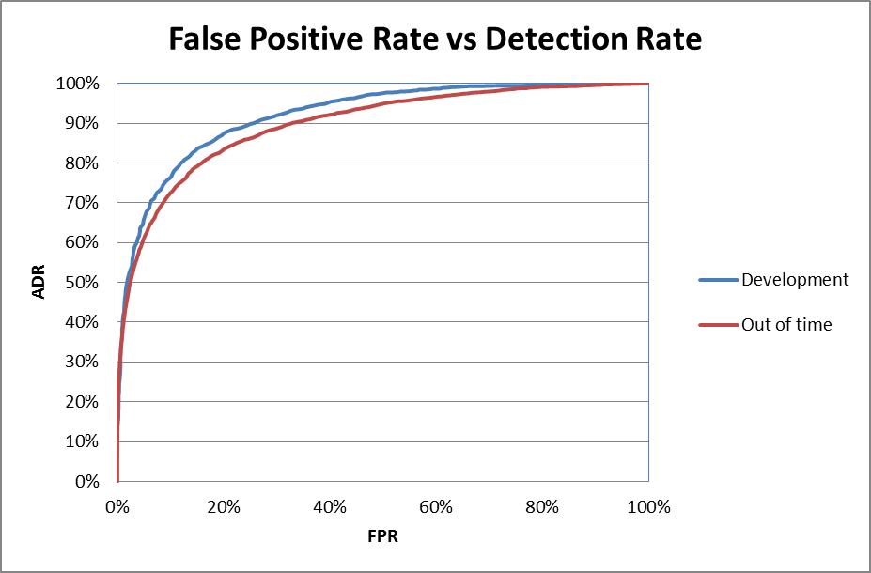
Application Fraud - Model Results
High Performance Credit Cards model.
Data included:
Application Data
Bureau Data
Customer Data
Match Rules Data
At a 5% review rate we have fraud detection rate of 66%.
Base fraud rate = 0.6%.
Time Period | Train/Test | ADR @ 800 | FPR @ 800 | Vol. @ 800 | Gini | ROC | KS-Stat | KS-Score
Development | Test | 65.7% | 4.9% | 5.0% | 96.0% | 98.0% | 68.5% | 669
Out of time | N/A | 64.0% | 5.9% | 6.0% | 94.8% | 97.4% | 64.2% | 705

Slide 49
Baseline Figures
Considered across multiple models and multiple geographies
Typical performance:
High Level Industry Stats (App fraud)
Average BFR (Base fraud Rate) = 1.2%
120 bps
Range [0.2% – 2.8%]
Credit Card
Avg. BFR = 1.0%
Range [0.65 – 2.25]
Loans
Avg. BFR = 1.4%
Range [0.2% – 2.8%]
At 5% review rate:
40% detection rate
20:1 FPR
At 10% review rate:
55% detection rate
30:1 FPR

Slide 50
Operational Factors

Slide 51
Application Fraud Model – Operational Review
The Application Fraud model scores can be monitored for the first 60 days following account opening or re-opening.
All high scores are referred
Low score orders can be fast-tracked
A Fraud model score is also generated using the account profile.
This score is monitored from account opening
After 60 days ONLY the fraud score is used
Protects against account takeover and bust-out frauds
Fraud model uses only the transactional order data
Velocity variables (number of orders, etc)
Product variables (type of goods)
Temporal

Slide 52
Model results and implementation
Improved fraud models yield greater detection, fewer reviews, or both
100%
Model A
Model B
2
% Fraud Detected
3
1
Random
1
Current detection rate and review rate
Reduce fraud losses at same review rate
Increase approvals at same detection rate
2
3
% Cases Reviewed
100%

Slide 53
Application Fraud Models – Typical Delivery Schedule
Project
Design
Data
Mapping
Data Extract
Data Summary
Modeling
Refine
Model
Model Report
Kick Off meeting Project definition Project plan. | Data Specification Review Data Mapping document. | Sample data supplied by client FICO data approval Data Extract and delivery by Client. Data Audit of supplied datasets Data Audit document | Application of Fraud tags to dataset. Data Summary (univariate stats) Fraud Benchmarking (based on tags applied) Summary Report | Development of model variables. Review of segmentation options and /or requirements. Model methodology selection. Model development Segmentation (if required – 2 weeks additional effort) Initial model results supplied for client review. | Model refinements based on review. Final model results. | Results meeting to review model report. Model packaging for deployment. Final model report.
2 weeks
2 weeks
3+ weeks
2 weeks
2 weeks
6 - 8 weeks
2 weeks
12 – 14 weeks from data readiness for one model

Slide 54
Application Fraud models and Credit Risk models
Differences and Similarities

Slide 55
Application Fraud and Credit Risk
Relationship between risk models and fraud models
Similarities
Data
Candidate Data fields can be identical
Target variable different (fraud vs risk)
1st party fraud model based on FPD can be very similar to some ‘high’ risk models.
Differences
Fraud models typically look for ‘binary’ outcome based on single threshold
Risk models should perform across the spectrum
Different weightings for variables (due to target definition)

Slide 56
Risk Factors
Risk Factors
Credit
Fraud
Assess ‘creditworthiness’
+ve factors:
Good financial history
Regular income
Use of previous credit products
Little or no default history
Personal Data – (limited address moves, family, dependents, etc.)
-ve factors:
Limited or no known financial history
Irregular income
Previous default behaviour
No fixed abode, etc.
Assess fraud risk
+ve factors:
Consistent Details
-ve factors:
One or more details matches negative file
Previous applications
No fixed abode (many address changes)
Recent activity (loans, cards)
Multiple recent applications
Inconsistent details (age, income, job title, home location)

Slide 57
Target Variable
Target Variables
Credit
Fraud
Assess ‘creditworthiness’
‘Bad’ definition
Liability to default: (Approved Apps only)
6 months
12 months
24 months
Default behaviour exclusions
30 days
60 days
90 days
x1, x2 in period
Assess fraud risk
‘Bad’ (fraud) definition
Fraud Declines
Early Payment Default
No payments (First Pay Default)
One payment (Second Pay Default)
3cycles+@6months
Exclusions
Any confirmed frauds not included in definition
Suspected fraud (if not included)
Other application declines?

Slide 58
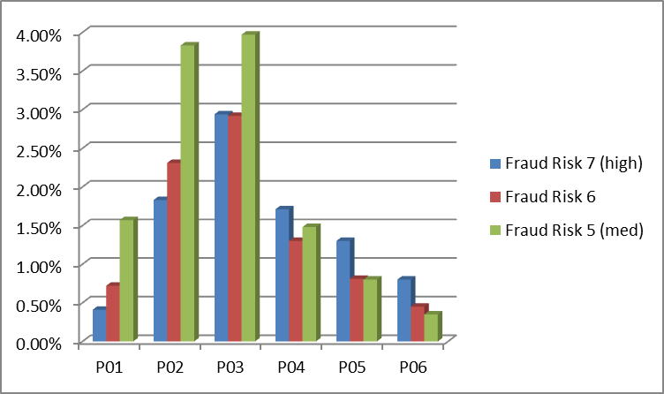
Application Fraud and Credit Risk
Correlation between application fraud score and risk score is usually limited:
FICO have done a number of analyses with customers
Bell-shaped curve typical (see graphic)
Highest fraud risk associated with middle credit risk bands
Population %
Credit risk band (low > high)

Slide 59
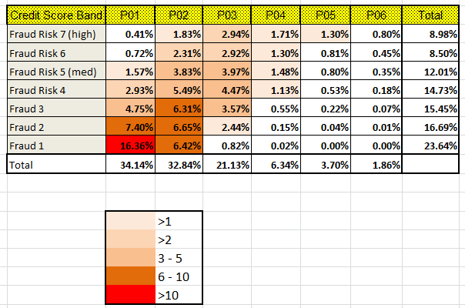
Risk Matrix

Slide 60
Appendix A
Tree-Ensemble Models

Slide 61
How Machine Learning Complements Domain Expertise
Optimal path
#
Domain Experts
1
Machine Learning
Great at intuiting key predictors
2
Lacks intuition
Intuition doesn’t scale to many variables
Excels at combining many derived features into accurate probability predictions
Poor at combining multiple predictors
Difficulties in quantifying uncertainty
4
3
Tell the “story” behind the numbers
Diagnose/visualize models to make sense

Slide 62
Key Analytic Elements of Our Approach
Powerful machine learning tools | Stochastic Gradient Boosting Black-box model visualization
Rich set of relevant variables/features | High-dimensional feature space of complex events Based on Recency and Frequency
Problem-oriented performance evaluation | Lift, portfolio profit gain Out-of-sample/Out-of-time

Slide 63
Stochastic Gradient Boosting
Training Data
Tree 1
Prediction Function
Tree 2
Weighted
average
Scored
Outcomes
Score
?
New case
Tree M
Predictors
Predictors
Score aggregates predictions from many shallow trees
Jerome Friedman^{[1]}
Notes:
Page 63

Slide 64
Demonstration Problem
Simulated Data
Outcomes
Noisy training samples
Predictive relationship from which data were generated (“ground truth”)
Predictors
Notes:
Page 64

Slide 65
Stochastic Gradient Boosting: 1 Shallow Tree
Tree 1
Weighted
Average
Notes:
Page 65

Slide 66
Stochastic Gradient Boosting: 5 Shallow Trees
Tree 1
Weighted
Average
Tree 5
Notes:
Page 66

Slide 67
Stochastic Gradient Boosting: 200 Shallow Trees
Tree 1
Weighted
Average
Tree 200
Notes:
Page 67

Slide 68
Credit Card Case Study
~5 million accounts generated: ~1 billion transactions over 3 years
Transaction information: Date, Merchant Code, Amount, Authorized Flag
2 years
6 months
Development
Observation Period
Performance Period
Time of Scoring
Out of Time Validation
Observation Period
Performance Period
Target Definition | Exclusions
0/1 indicator of card activity during performance period | Less than 3 transactions during observation period or Card not used within 3 months prior to Time of Scoring

Slide 69
XIE XIE
August, 2016
Derek Dempsey
DerekDempsey@fico.com
Fair Isaac Advisors

